Slide 1

Time Management
Faculty : Mr. Yashwant Patil
GM – H R

Slide 2
Time Management : What is it?
Doing the Right things and not doing things Right (Efficiency)
In control of Life , not driven by circumstances
Enjoying Journey of Life : Every day of it not a perfect day in future
Having Right Balance in Wheel of Life
Manage yourself in the given time

Slide 3

Why do we need Time Management
To save Time
To Reduce Stress
To function effectively
To Increase our work output
To have more control over our job responsibilities

Slide 4
How to use Time Effectively
Know How to Spend your Time
Set Priorities
Use a Planning Tool
Get organized
Schedule your time appropriately
Delegate –Get help from others
Stop Procrastinating
Manage External Time Waster
Handle Crisis Situation
Stay Healthy

Slide 5

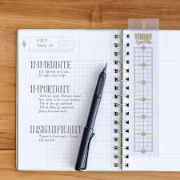
1.Know how to spend your Time
Keeping a Record of your Task
Evaluate the results
Self Analysis –Task which is taking more time
Investment of time on important activities
Realistic Planning
2. Set Priorities & Goals
Follow Time Management Matrix
Follow To do List – daily weekly monthly
Rank Items in order of priority
Focus on urgent and Important activity

Slide 6
Creating TO DO Lists
Your Daily list of Tasks
Tasks that take you towards your Goal
 | Urgent | Not Urgent
Important | Do Now Project with Deadlines Crises (Personal & Professional) 3)Deadline and Firefighting | Spend mote time on Relationship Maintenance Recreation Main Projects Planning, Holidays
Not Important | Do Quickly Routine Activities (Calls , emails , reports etc.) Interruptions , Meetings | Reject or Decrease Time Wasters (Calls , emails, checking Facebook internet surfing etc.) 2)Junk Mail , Time Wasters
One Sheet a Day
Task with defined Importance

Slide 7
Working with TO DO Lists
Create the list before you start the day
15 Minutes of investment will help you everyday
TO DO LIST
End of the day : Review Status
Status C- Completed , T – Transferred ,A- Abandoned , I – In progress
TO DO LIST

Slide 8
Sample TO DO List
Date: 30-Nov-2007
Task | Priority | Status | Time needed
Prepare Slides | Q1 | C | 30 min
Collect Photos (T-1) | Q2 |  | 45 min
Add Slides to qaweb | Q3 |  | 5 min
Update SDK Test Cases | Q1 |  | 1 hour
Confirm to Shivaji about tomorrow’s plan | Q1 | C | 5 min

Slide 9
Goals
“If you are not aware of the direction you are getting , you will end up exactly where you are going”
Focusing on important areas of Life : Family , Work , health , personal Development , Finance
A goal is anything you want to accomplish in your Life.
If you had only 6 months Live : what are the things you want to do.
Written Goals
Palest Ink is better than brightest Memory.
It is not enough to have goals in Mind.
Put them down on Paper
It is an agreement with yourself that you are aware of goals and will peruse them.

Slide 10
Hints to Find Goals
1. What do you want to accomplish | 2.Long Term Goals
3.Dreams /Ambitions | 4.Work Goals
5.Professional Goals

Slide 11

3.Use a Planning Tool
1. Record all information in that tool
2. Review it daily and modify if necessary.
3.Assign different color code for your understanding
4.Maintain a calendar – Meetings or personal work
5. Assign deadlines for each Task
4. Get Organized
1. Sort your Things under three tag “Keep” , Give Away “ and “Toss:
Toss – discard items immediately
Give Away Box- Items you want to sell , delegate or discontinue
Keep – To handle information carefully

Slide 12

5.Schedule your time appropriately
Schedule Time
1.Commitment to the things you want to do
2. Use your time Log.
3.Plan your challenging task when you have the most energy
4.Block your time for your high priority activities first.
Schedule Time
5. Save some time for Planning and Thinking
Schedule Time
6. Delegate : Get help from others
Assign responsibilities for a task to someone
Check occasionally about the progress of work
Identify task that others can do and selecting a person to do that task
Don’t forget to reward the person
Define your task and your expectation

Slide 13

7. Stop Procrastinating
1. No Excuse
2. Priotize
3. Do It Now
4. Understand how much time it takes to do the task
5.Not all tasks take sometime
6.Understand what and why of your procrastination tendency
7.Do not be as last minute decision taker
8.Gather Information for a task in advance
9. “….If we wait for the moment when everything , absolutely everything is ready, we shall never begin”

Slide 14

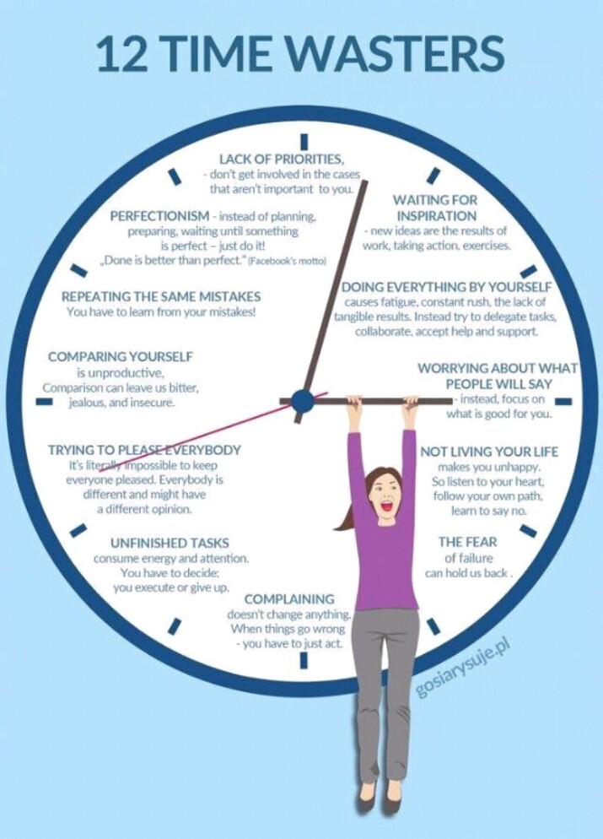
8. Manage External Time Waster

Slide 15
8. Manage External Time Waster
Telephone :
Use Voice call and set aside time to return calls
Avoid small talk , stay focused on the reason for the call
Stand up while you talk on the phone. You are more likely to keep the conversation brief.
Take any necessary action immediately following the call.
Set aside times of the day for receiving calls and let others know when you are available
Keep phone numbers readily available near the telephone.

Slide 16
8. Manage External Time Waster
Establish Blocks of time when you are available for visits
Unexpected Visitors
Tell the visitor Politely that you cannot meet with them at this time and schedule the visits for a more convenient time.
Set a mutually agreeable time limit for the visit .
When someone comes to the door , stand up and have your meeting standing

Slide 17
8. Manage External Time Waster
Know the purpose of the meeting in advance.
Arrive on time.
Meetings
Start and end the meeting on time
Prepare an agenda and stick to it. Use a timed agenda, if necessary.
Don’t schedule meetings unless they are necessary and have a specific purpose or agenda.

Slide 18
8. Manage External Time Waster
Set aside a specific time to view and respond to your mail and email but don’t let it accumulate to the point that it becomes overwhelming to sort.
Mails and Emails
Turn off instant messaging features on E mail.
Handle each items only once ,if possible . Practice the options for dealing with clutter listed earlier .
Sort mail near a garbage can and delete junk e-mail immediately from your electronic mailbox.
Answer written messages by responding on the margins or bottom of the page.

Slide 19

8. Manage External Time Waster
Establish a master calendar for each family member to post their time commitments.
Families and Obligation
Make each family member responsible for consulting the master calendar for potential conflicts.
Create a central area for posting communications such as appointment reminders, announcements, and messages.

Slide 20

Common Problem – While Managing Time
I am Busy
I don’t have time
I am not happy with my life
I don’t feel I have achieved anything this year
I don’t have control on my life
I wish I have more than 24 hours per day so that I can get more things done

Slide 21
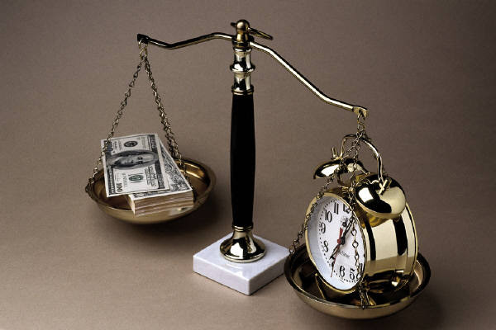
Balance your life
Balance in Life is important
Recognize each aspect of life is important
I am not getting enough time for family/personal life because of Work
80% of day is spent at work
Family
Health
Finance
Work

Slide 22
9. Handle Crisis Situations
Be Proactive not reactive .
Being Proactive is highly motivating
Maintain a crisis Log
Prevent crisis by managing important but not urgent tasks on time.

Slide 23

10. Stay Healthy
Schedule time to relax and reward yourself for a time management success
Take time to recognize that you have accomplished a major task
Care and attention you give yourself is important

Slide 24

Tips
SWOT Analysis : Strengths, Weaknesses, Opportunities, Threats
Get up 15 minutes early
Make time for ‘yourself’
Understand your ‘effective time zone’
Deal effectively with interruptions
Update your to do list daily
Do not over-schedule
Keep your list in sight
Delegate, if possible
Get Organized: paper, e-mail
Do difficult tasks first

Slide 25
My Experience
Spent hours to list all my goals in life
Daily Lists made every day (95% of time)
Examples of goals
  Recurring Goals:
    Daily follow-ups
    Instructions from superiors
    Prepare Monthly Status report, MRM, PQCDSM, etc.
  Long term goals
    Buy a house
  Personal development
    Reading books
      Buy/loan book
      Read 1 chapter per day

Slide 26
Task Analysis
TASK ANALYSIS FOR 3 MONTHS
Only 65-70% of planned activities were completed during each month
20% of planned activities are transferred at least once.
10-12% of activities are abandoned
On an average I take up 4-5 activities per day in addition to work related responsibilities

Slide 27
Lessons Learned
I have plenty of time on hand. If an activity takes average of 30 min, I have a workload of 2-3 hours per day besides the daily routine tasks. There is lot of time that can be utilized effectively
10% of activities are 'not necessary' but I plan them because I think should do it. But not achieving them does not have an impact at all in achieving my goals.
20% of activities are postponed because I do not set realistic targets or I do not do enough preparation to complete the activity.

Slide 28
Time Kit
One source for everything
  Goals
  Tasks
  Expenses
  Phone Book
  Ideas/Notes
  Lists: Books to read, Movies to watch, checklists
Chaos to ORGANIZED

Slide 29
Getting Started
Write down Goals of your life
Write down Goals of your life
Write down Goals of your life
Time management is toughest course on offer and many fail.
Practice TO DO Lists for at least 3 months
Then it becomes a habit
Don’t give up
If you fail to plan, you plan to FAIL.

Slide 30
Quick Revision
Writing down goals is the first important step
Break down goals to tasks
Understand your ‘most effective time zone’/’time span’
Create Daily TO DO List for next 3 months
A Page a day works best
We have more time available than we ‘think’
DO IT NOW
Make time management a ‘habit’
Don’t Give up: Stay motivated
Achieve more in less time

Slide 31
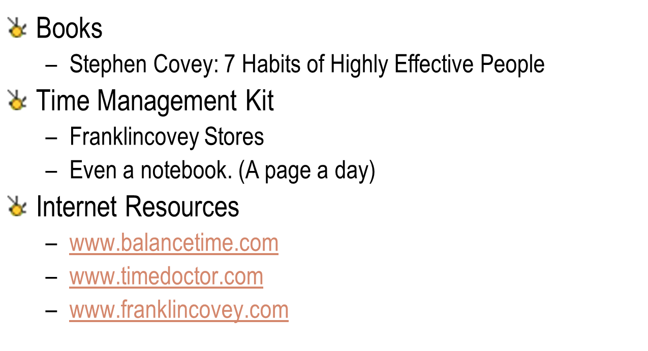
Resources

Slide 32

“If fail to Plan, you plan to fail”
“Plan never fails, we fail to plan”

